Slide 1
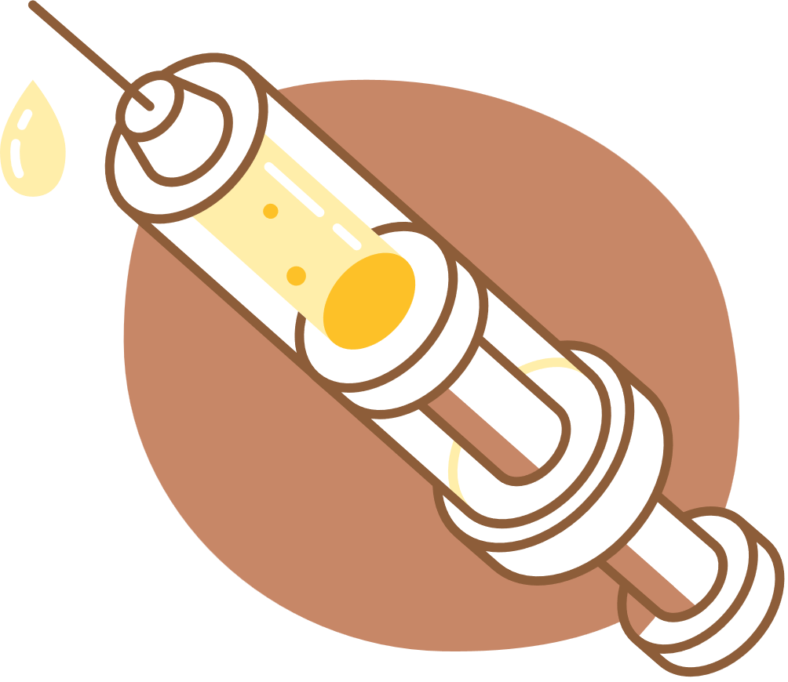


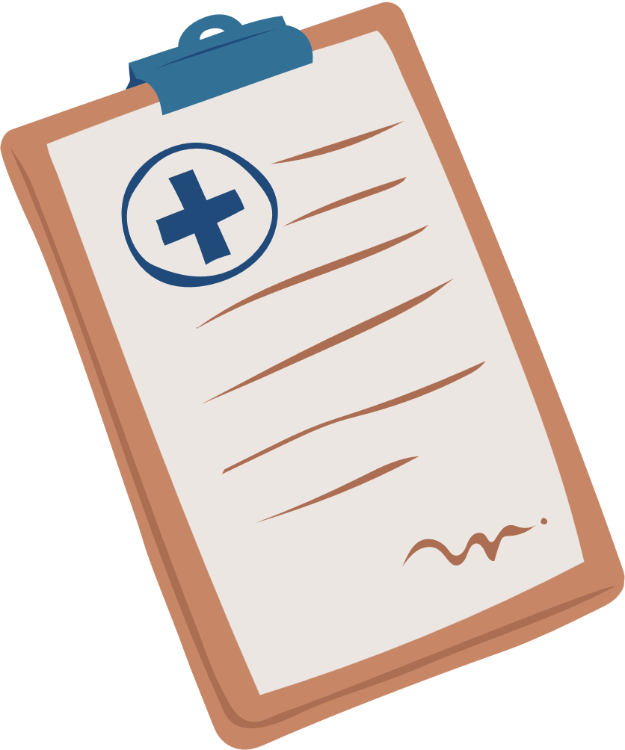
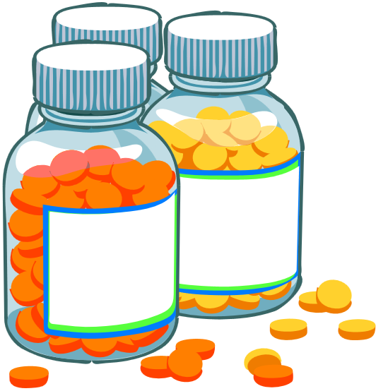
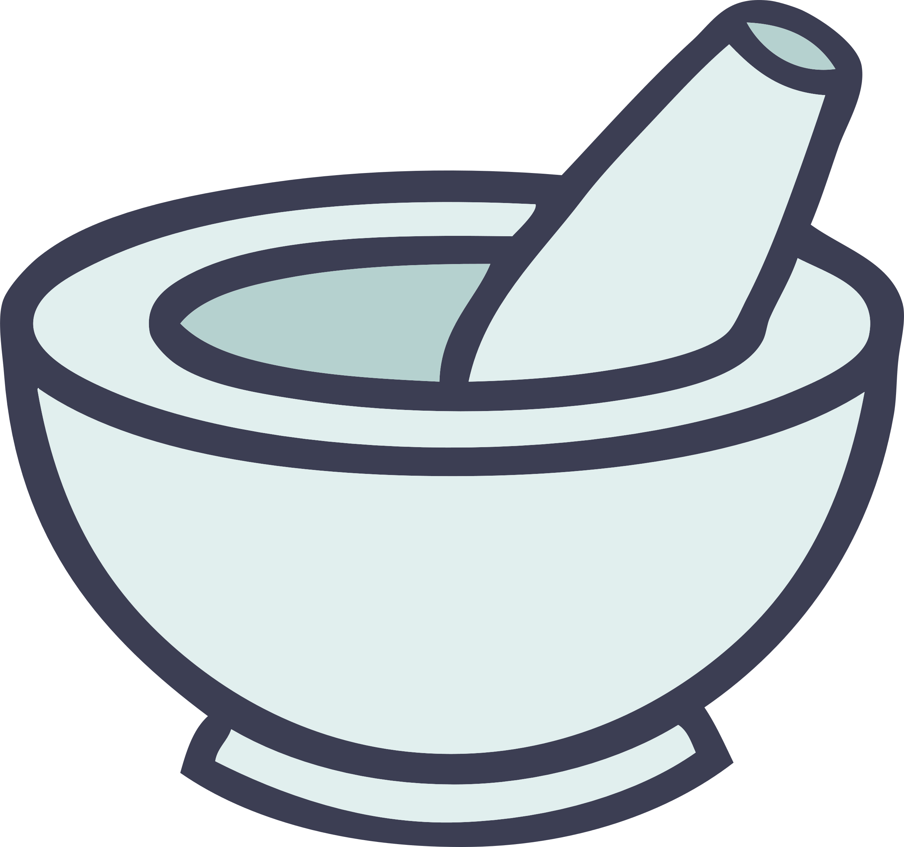
Pharma
Chain
FDA-verified Cold-Chain Drug Tracking with Realtime Telemetry
GitHub Repository: [https://github.com/bursurajesh104-beep/pharmachain]

Slide 2
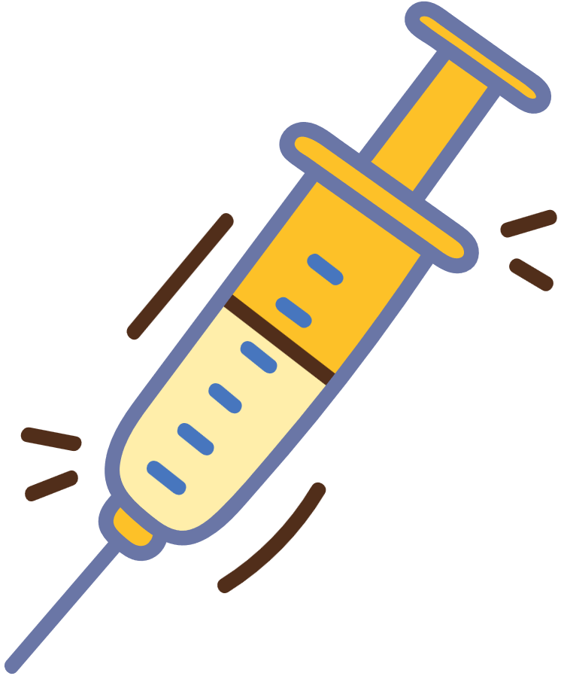
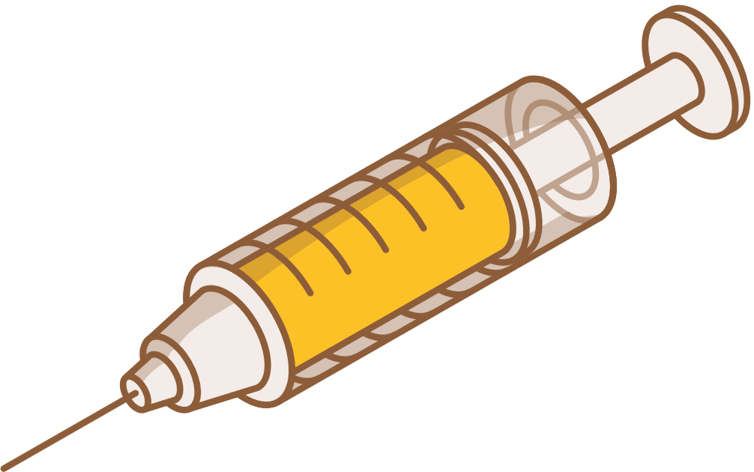
Our Team
S.NO | NAME | REGISTOR NUMBER
1 | B.Rajesh | 9923005010
2 | Krishna raj | 99230050286

Slide 3
Problem Statement
  Lack of transparency in drug supply chain
  Temperature abuse during transit leads to ineffective or harmful drugs
  No unified system for monitoring, tracking, and certifying drug status
  Need for tamper-proof, verifiable, and realtime control

Slide 4
Solution
  End-to-end tracking: Manufacturer → FDA → Distributor → Client
  Live telemetry from IoT sensors (ESP32 + DHT11)
  GPS location tracking for every step
  Hash-chained events ensure data integrity
  Supabase (MYSQL + Realtime API) as backend

Slide 5
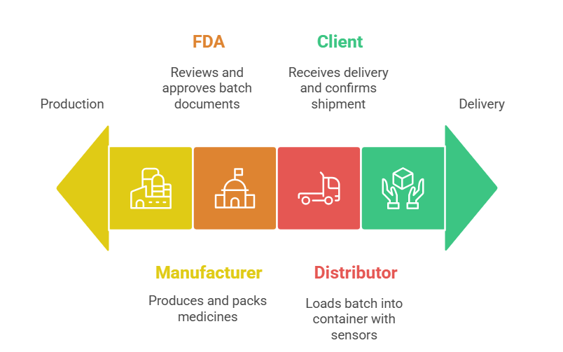
System Architecture

Slide 6
Core Features
  End-to-end chain-of-custody tracking with role-based access (Manufacturer → FDA → Distributor → Client)
  Live telemetry: Temperature, humidity, and GPS from ESP32+DHT11 sensor every 10 seconds
  Tamper-proof event logging using SHA-256 hash-chained records
  Realtime dashboard with charts, map, alerts, and CSV export

Slide 7
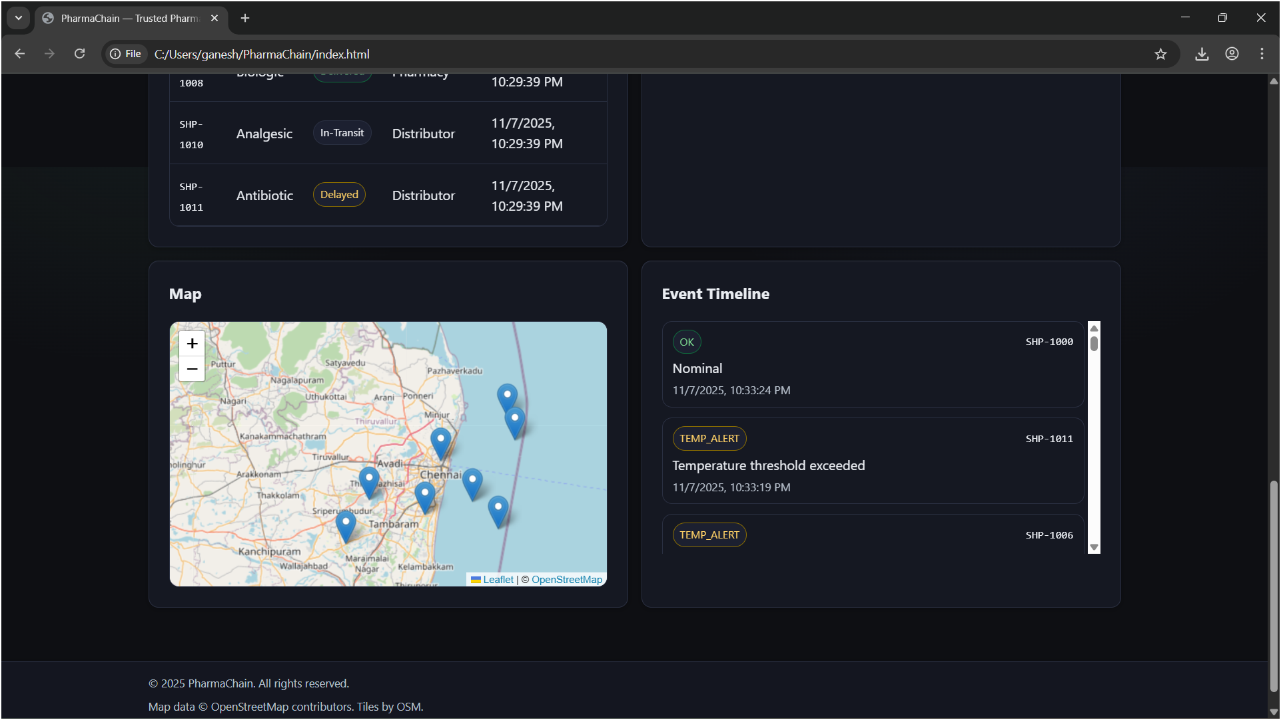
Realtime Tracker View
For the Static Data we used the Dataset
link >
sensors_2025-11-07T17-10-53-789Z.csv.xlsx

Slide 8
Conclusion
PharmaChain delivers a secure, scalable, and transparent cold-chain tracking solution for pharmaceuticals, ensuring temperature integrity and regulatory compliance throughout the supply chain. By integrating IoT sensors, real-time telemetry, role-based workflows, and blockchain-inspired hash verification, it establishes trust across all stakeholders—Manufacturer, FDA, Distributor, and Client. This system not only minimizes the risk of spoiled or tampered drugs but also sets a foundation for modern, data-driven healthcare logistics.

Slide 9
Thank You

